Slide 1
Restaurant Bill Management System
Kavya Garg -RA1911003010807
Prashi Kumar-RA1911003010818
Tarun Bolisetty-RA1911003010819

Slide 2
The project intends to provide a solution to implement the Restaurant Bill Management System, using a database and web pages to interact with the database.

Slide 3
Introduction
Nowadays web services technology is widely used to integrate heterogeneous systems and develop new applications. Here an application of integration of restaurant management systems by web services technology is presented. Smart Restaurant integrates lots of systems of hotel industry such as Ordering System Kitchen Order Ticket (KOT), Billing System and various services booking. This integration solution can add or expand hotel software system in any size of hotel chains environment.

Slide 4
Problem Statement
Traditionally the method in which customers specify their desired menu to the waiter who takes the order on a paper. Personally, he then takes the order to the kitchen department and then he supply the food item to the customer. So, it was a time-consuming process. It leads to wastage of paper and also it requires reprinting of all menu cards. Also, in many cases for small change to be making in menu card it is not convenient to print all menu cards again and again. Simply saying that the menu card once printed can’t be changed. After some days, the menu card lost its worthy look and attractiveness.
Many of the hotel are managed their workflow and services by paper work and manually which take time and high budget for management. busy day of people schedule and value of time become important day by day so Smart Restaurant handle the system as booking and ordering by digitally which become save manpower and time of staff of hotel. Generating KOT by application is easy to save paper, staff and time. The hotel are services and facilized in a traditional way, from waiters to kitchen also on account. More recently, these system is one of the major problem for hotel to manage their manpower and guests.

Slide 5
Why is it required?
This system is to automate day to day activity of a restaurant. Restaurant is a kind of business that serves people all over world with ready-made food. This system is to provide service facility to restaurant and also to the customer. This restaurant management system can be used by employees in a restaurant to handle the clients, their orders and can help them easily find free tables or place orders. The services that are provided is food ordering and reservation table management by the custom.
Primary Objectives
The main objective of this project is to make the ordering system of restaurant digital and effective. People would not have to wait for ordering the food and any kind of booking services which will be eliminating delay in services.
Features:
- To provide a feature rich for Digital KOT service
- To provide efficient management of users divided in 3 general categories as Guest User, Waiters/kitchen and Account.
- To build a feature rich for Automatic billing.
- To provide efficient Kitchen Display of KOT
Secondary Objectives
- To enable guest to search and view the menus of hotel and their restaurant.
- To provide a platform itself being a select and order the menus and book services.

Slide 6




Tools used:

Slide 7
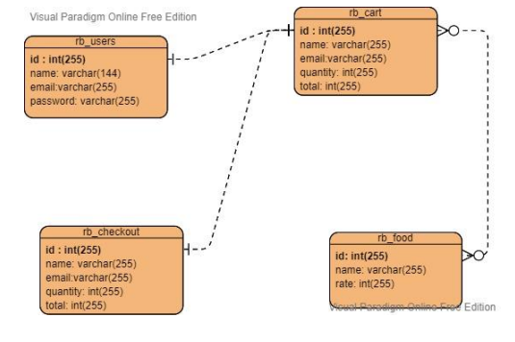
ER DIAGRAM:

Slide 8
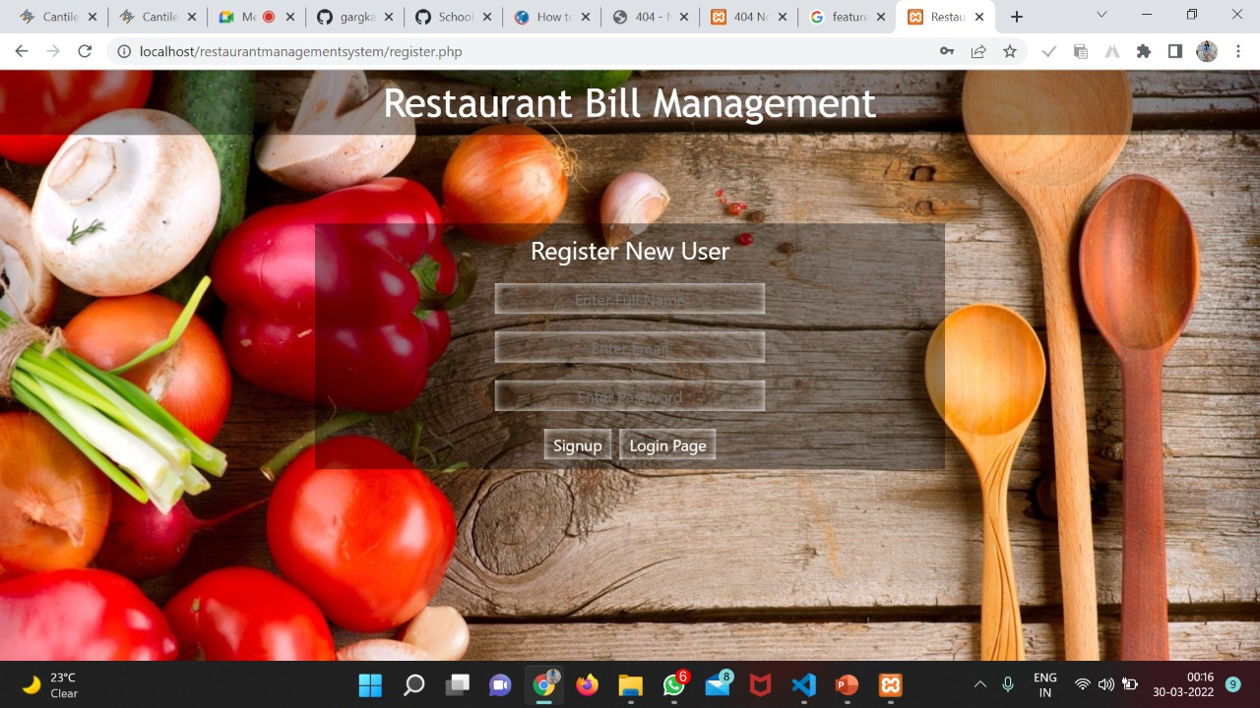
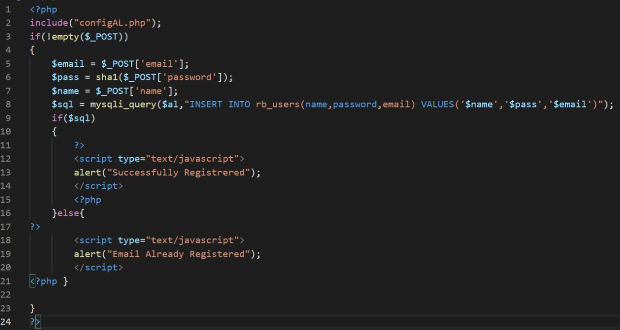
REGISTRATION:

Slide 9
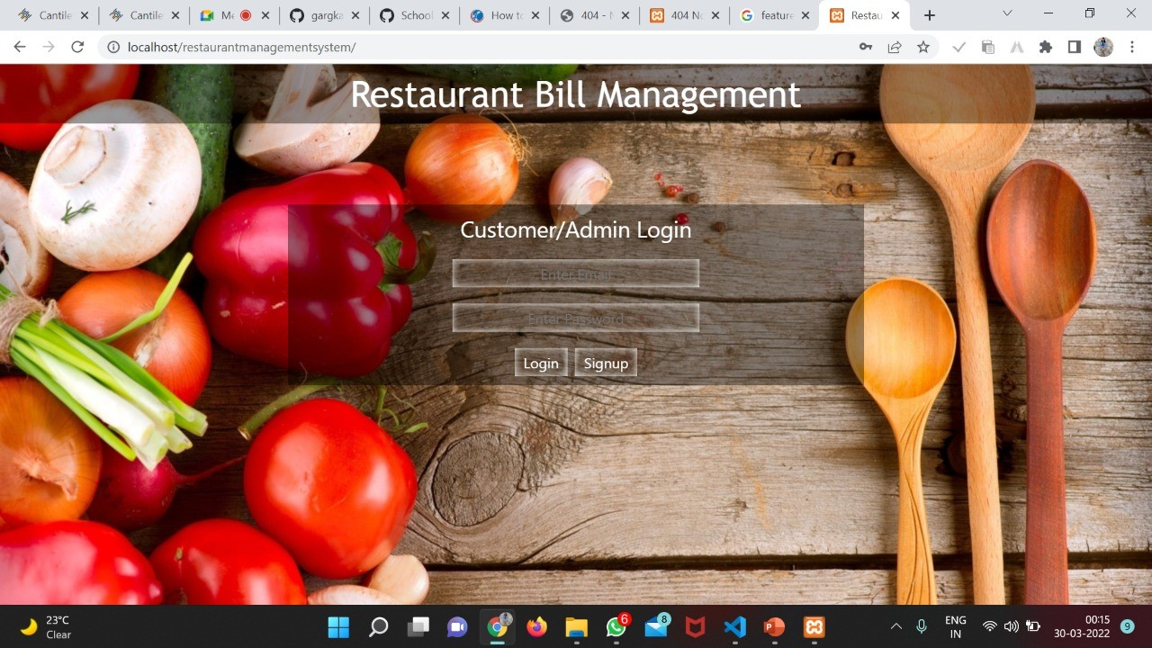
LOGIN:

Slide 10
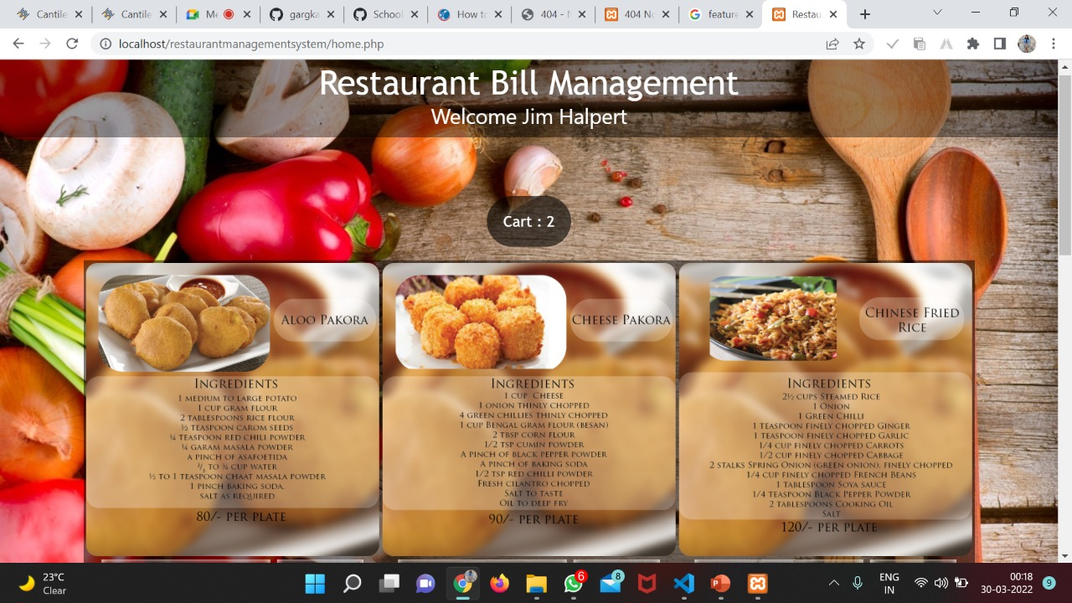
CUSTOMER’S ORDER / MENU:

Slide 11
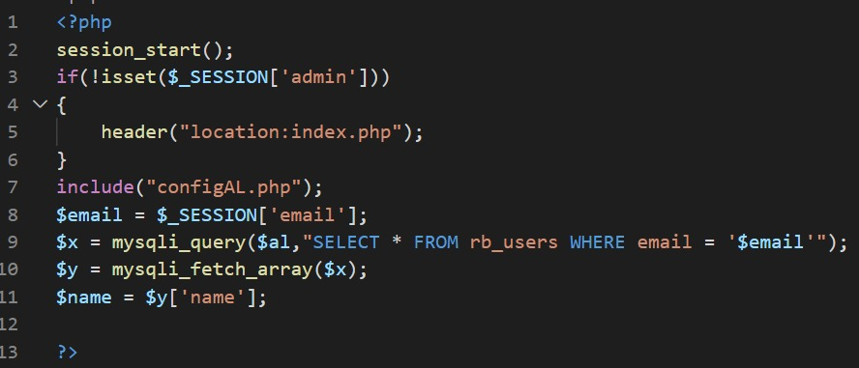
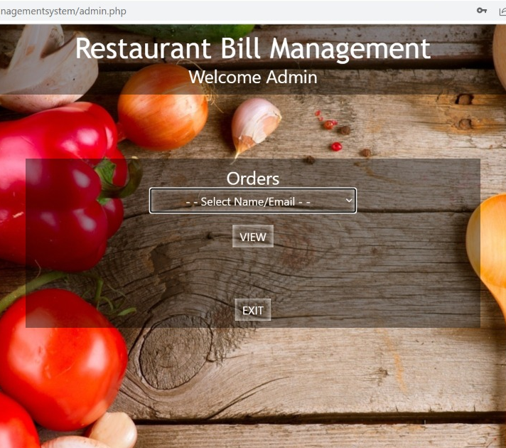
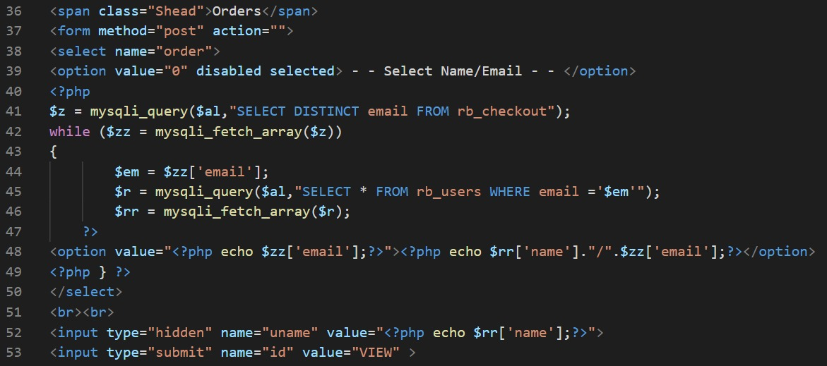
ADMIN :

Slide 12
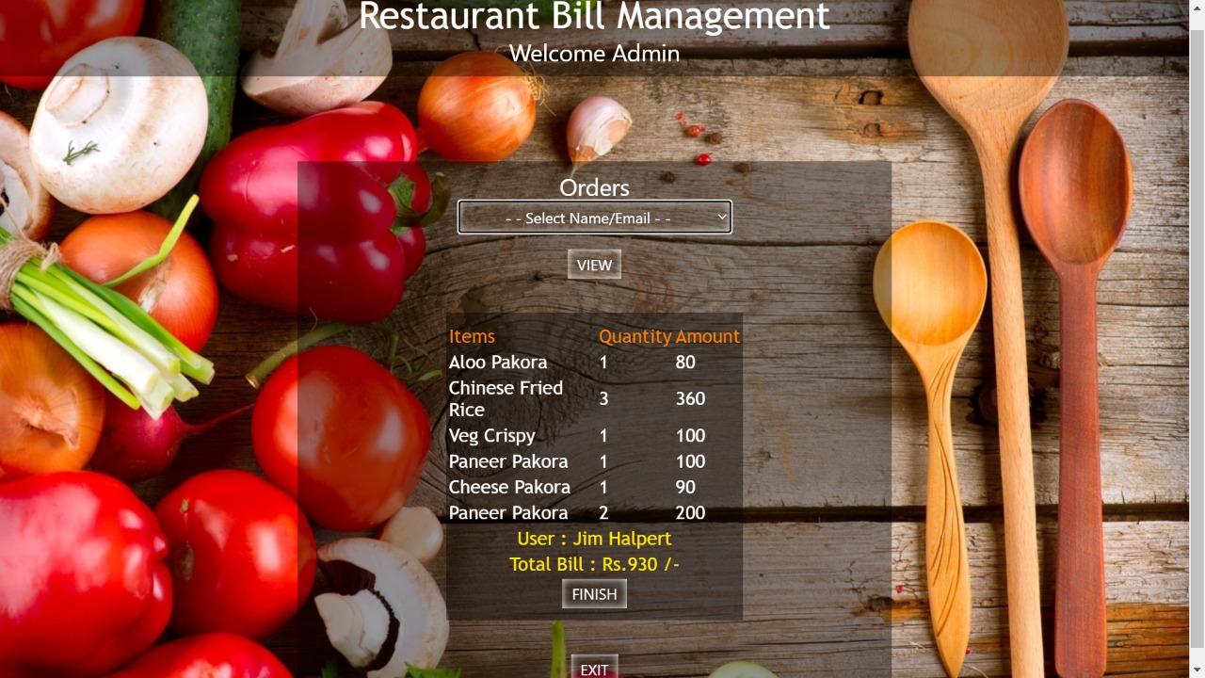
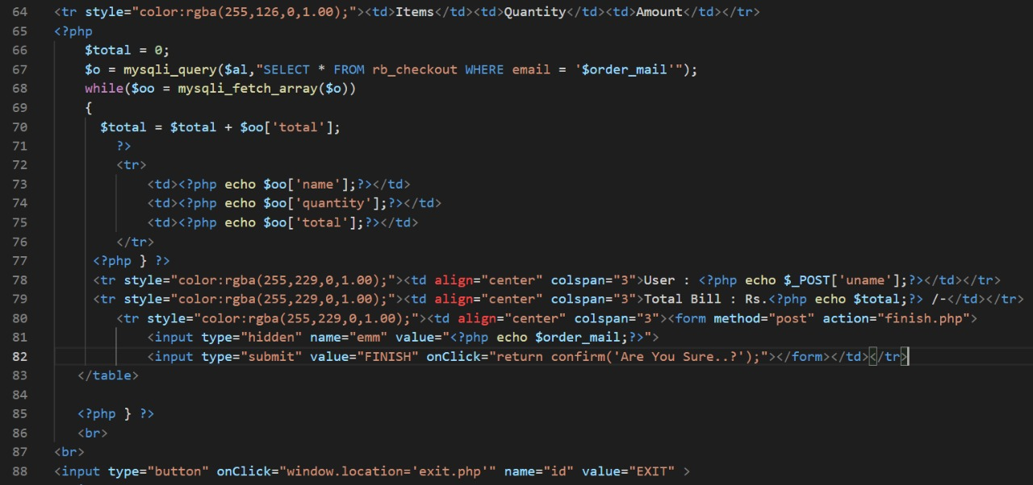
BILLING:

Slide 13
THANK YOU!

